Slide 1
Security Services &
Intrusion Detection techniques
Dr. Harmeet Singh
Dept. of Computer Science & Engg.
Sant Baba Bhag Singh University,Jalandhar

Slide 2
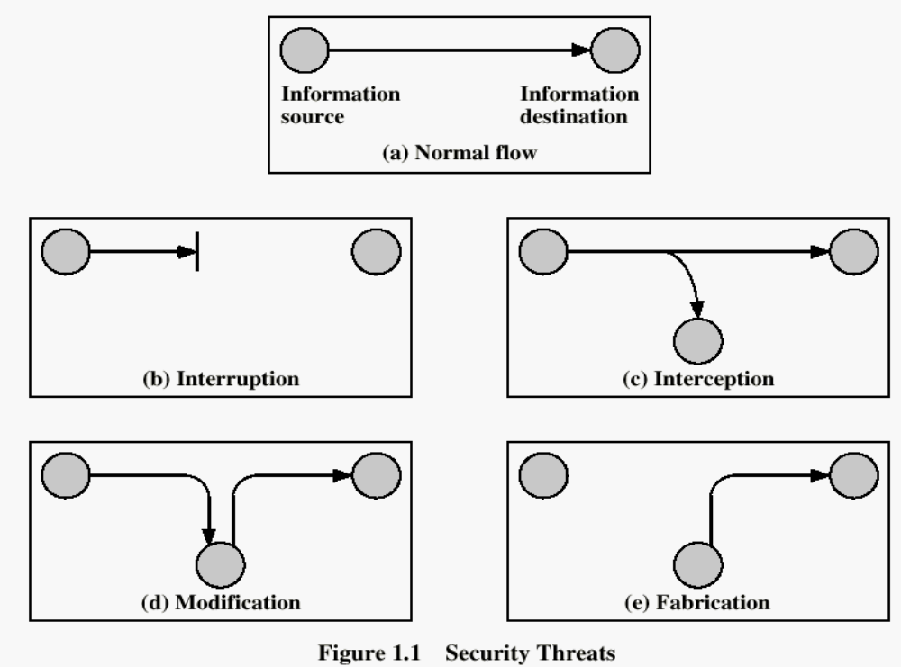
Security Attack Classification

Slide 3
Security Attack Classification
Interruption: (an attack on availability) : An asset of the system is destroyed or becomes unavailable or unusable – by an unauthorized party
Interception: (an attack on Confidentiality): An unauthorized party gains access to an asset by observing the communication.
Modification: (an attack integrity) : An unauthorized party not only gains access to but tampers with an asset – “Man in the middle”
Fabrication: (an attack on authenticity): An unauthorized party inserts counterfeit objects into the system

Slide 4
Security Services
A service that enhances the security of data processing systems and information transfers. A security service makes use of one or more security mechanisms.
Authentication: assurance that an entity of concern or the origin of a communication is authentic - it’s what it claims to be or from
Non-repudiation: offer of evidence that a party indeed is the sender or a receiver of certain information
Access control: facilities to determine and enforce who is allowed access to what resources, hosts, software, network connections

Slide 5
Security Services
Monitor & response: facilities for monitoring security attacks, generating indications, surviving (tolerating) and recovering from attacks
Security management: facilities for coordinating users’ service requirements and mechanism implementations throughout the enterprise network and across the Internet
Trust model
Trust communication protocol
Trust management infrastructure

Slide 6
Impacts of Attacks
Theft of confidential information
Unauthorized use of
>Network bandwidth
>Computing resource
Spread of false information
Disruption of legitimate services

Slide 7
Intrusion & Intrusion Detection System
Intrusion is sequence of unwanted events that denied the services and try to cause harm to system.
An intrusion-detection system (IDS) is the process of monitoring the events occurring in a computer system or network and analyzing them to identify unauthorized access or violation of security policies.

Slide 8
Types of IDS
Network Intrusion Detection Systems
The intrusion comes from various directions the network-based IDS analyze and watches/monitors the traffic on communication network to detect the same. An Intrusion detection system can be built from number of sensors, each and every sensor monitoring the traffic in and out by its owned network segments
Host-Based Intrusion Detection Systems
A host based IDS tracks and monitors the directories and essential files change reside on systems. It takes current system files snap shot for matching with the earlier snap shot.

Slide 9
Intrusion Detection techniques
Signature-Based Intrusion Detection Systems
Also termed as misuse detection intrusion detection system. In this mechanism attack patterns are stored inside the database. Each packet of the network traffic is as compared with the attack patterns for abnormal behavior detection. Signature based intrusion detection approach works similar to the antivirus software.
Anomaly-Based Intrusion Detection Systems
Anomaly-based detection systems are also called as behaviors based intrusion detection system. It is based on network behavior. The network behavior is defined by the administrator or is learned by dataset for the duration of the training segment of the improvement of IDS. Rules are described for abnormal behavior and normal behavior.

Slide 10

Thank You

